Slide 1




Environmental influence on the Atlantic salmon epigenome during sea lice infestation
Shelly Trigg, Ph.D.
Steven Roberts Lab
School of Aquatic and Fishery Sciences
University of Washington
In collaboration with Cristian Gallardo-Escárate, Valentina Valenzuela-Muñoz, and Gustavo Núñez-Acuña
Universidad de Concepción, Chile

Slide 2
Environmental threats to Salmon
Warming (S. salar are in fact pretty tolerant to warm water)
Change in salinity
Warm + salinity make sea lice more challenging
These factors affect salmon physiology
methylation is a good metric to look for change

Slide 3
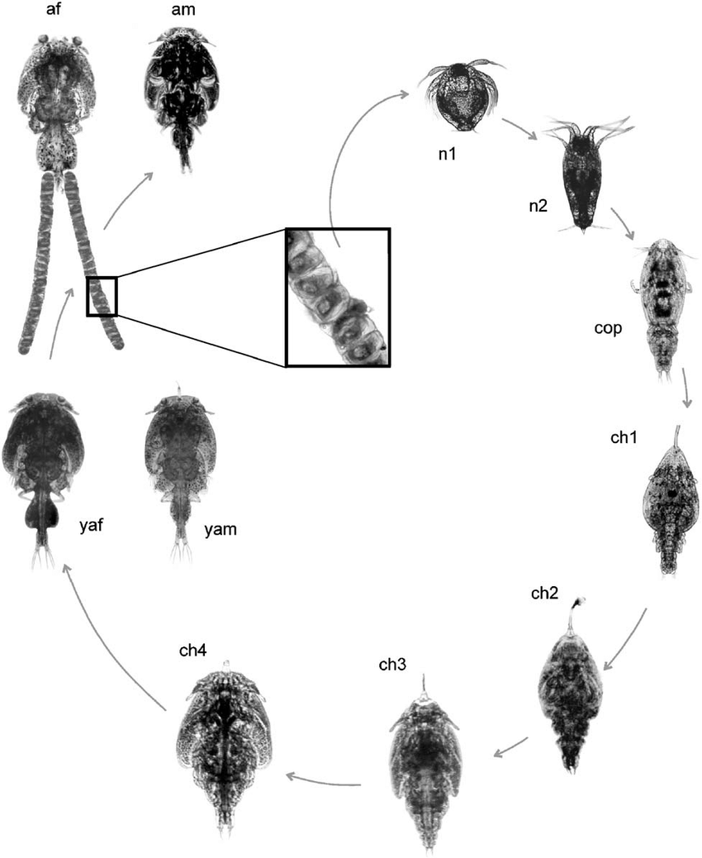
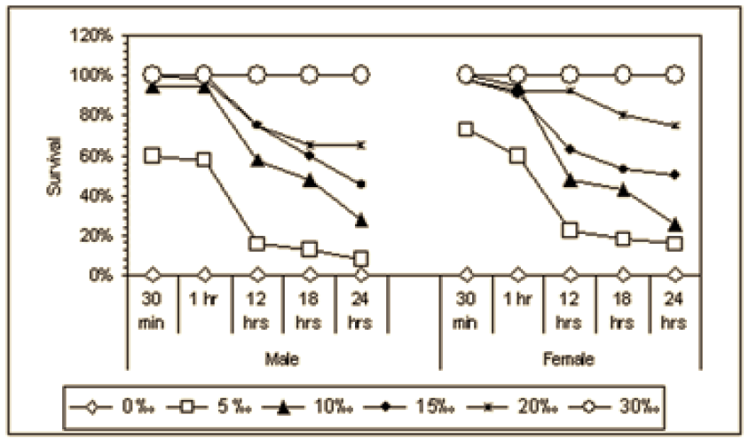
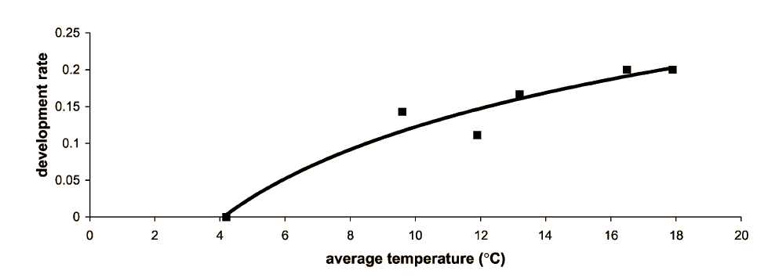
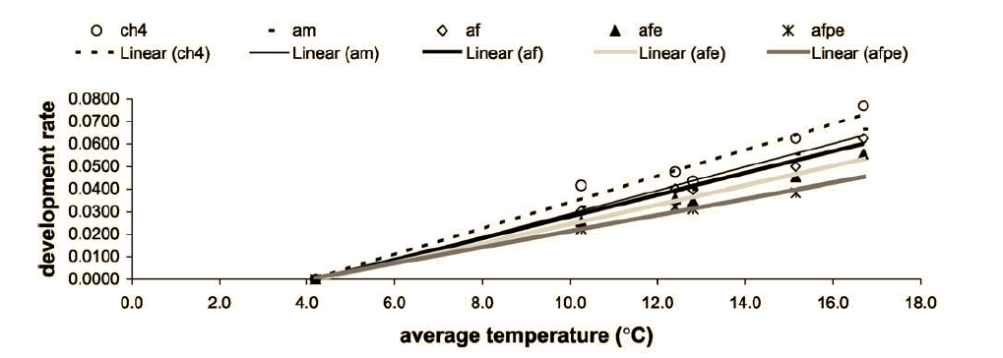
Environment influence on sea lice
Salinity affects survival
Temperature affects growth
González Poblete, Laura & Carvajal, Juan. (2003). Life cycle of Caligus rogercresseyi, (Copepoda: Caligidae) parasite of Chilean reared salmonids. Aquaculture. 220. 101-117. 10.1016/S0044-8486(02)00512-4.

Slide 4


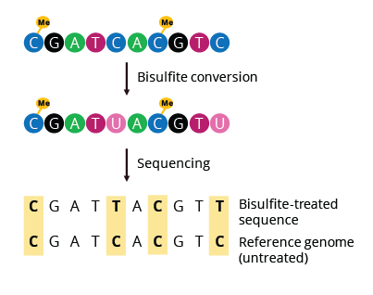
Experimental set-up
8 fish/tank, 35 sea lice/fish, 4 tanks/treatment for 30 days
Reduced-Representation
Bisulfite Sequencing
8°C
MspI +TaqαI digest
16°C
32 psu
26 psu
Notes:
add

Slide 5
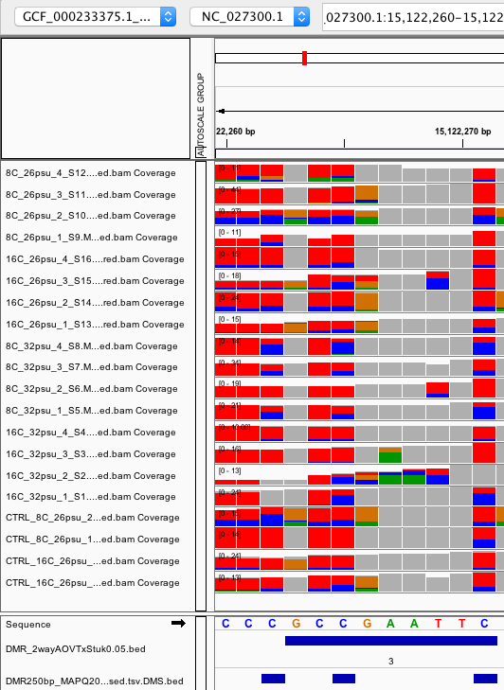
DMR: Differentially methylated region
A 10 - 300bp region containing at least 3 CpGs with 5x coverage in ¾ individuals per group that are:
significantly differentially methylated from expected genetic origins of methylation variation
significantly differentially methylated across experimental groups
Blue = # mCpGs
Red = # CpGs
26 PSU
32 PSU
26 PSU
controls
(no sea lice)
Notes:
Filtered at 5x coverage within a sample and 3x coverage by individuals within a group

Slide 6
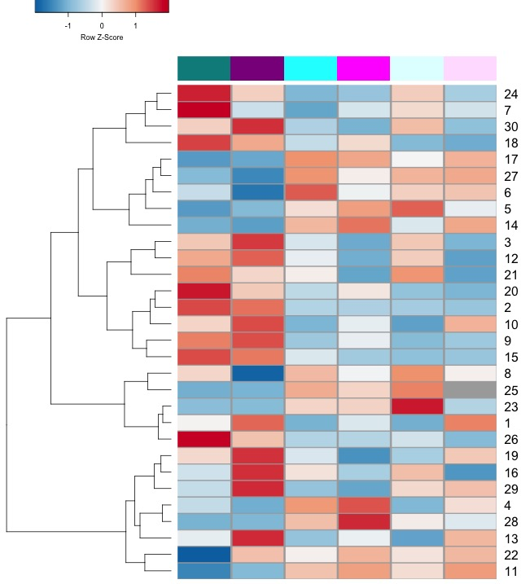
Influence of salinity on methylation
Relative % methylation
8°C
32PSU
16°C
32PSU
8°C
26PSU
16°C
26PSU
Notes:
Significant DMRs; colored by temperature and shaded by salinity

Slide 7
Influence of salinity on methylation
Relative % methylation
8°C
32PSU
16°C
32PSU
8°C
26PSU
16°C
26PSU
Notes:
Significant DMRs

Slide 8
Influence of salinity on methylation
Relative % methylation
SEA LICE
NO SEA LICE
8°C
32PSU
16°C
32PSU
8°C
26PSU
16°C
26PSU
8°C
26PSU
16°C
26PSU
Dependent on salinity AND sea lice
Notes:
Significant DMRs

Slide 9
Influence of salinity on methylation
Relative % methylation
SEA LICE
NO SEA LICE
8°C
32PSU
16°C
32PSU
8°C
26PSU
16°C
26PSU
8°C
26PSU
16°C
26PSU
LBX1
Homeobox transcription factors
Involved in cell differentiation and multicellular organism development, region specificity of skin (Chuong, 2003 J Invest Dermatol.)
Gene-body hypermethylation is associated with elevated HOX expression (Li, Huang, Wei 2019 Cancers)
HOXC8
HOXC9
Notes:
Gene body methylation and downstream of gene. Are their targets?
HoxC8 over expression inhibits glycolysis (decreases glucose uptake and lactate production) and increases TCA activity (https://www.ncbi.nlm.nih.gov/pmc/articles/PMC4564361/)

Slide 10
Influence of salinity on methylation
Relative % methylation
SEA LICE
NO SEA LICE
8°C
32PSU
16°C
32PSU
8°C
26PSU
16°C
26PSU
8°C
26PSU
16°C
26PSU
High temperature alone is not enough to elicit this response
LBX1
HOXC8
HOXC9
Notes:
Gene body methylation and downstream of gene. Are their targets?
HoxC8 over expression inhibits glycolysis (decreases glucose uptake and lactate production) and increases TCA activity (https://www.ncbi.nlm.nih.gov/pmc/articles/PMC4564361/)

Slide 11
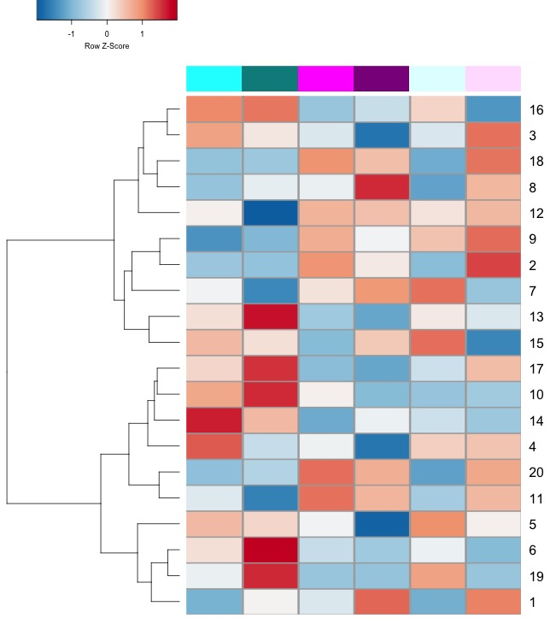
Influence of temperature on methylation
Relative % methylation
8°C
26PSU
8°C
32PSU
16°C
26PSU
16°C
32PSU
8°C
26PSU
16°C
26PSU
Notes:
Significant DMRs

Slide 12
Influence of temperature on methylation
Relative % methylation
8°C
26PSU
8°C
32PSU
16°C
26PSU
16°C
32PSU
8°C
26PSU
16°C
26PSU
Increase in methylation under low temperature(8C)
Notes:
Significant DMRs

Slide 13
Influence of temperature on methylation
Relative % methylation
SEA LICE
NO SEA LICE
8°C
26PSU
8°C
32PSU
16°C
26PSU
16°C
32PSU
8°C
26PSU
16°C
26PSU
Sea lice dependent Increase in methylation under low temperature (8C)
Notes:
Significant DMRs

Slide 14
Influence of temperature on methylation
Relative % methylation
SEA LICE
NO SEA LICE
8°C
26PSU
8°C
32PSU
16°C
26PSU
16°C
32PSU
8°C
26PSU
16°C
26PSU
function
Notes:
Significant DMRs

Slide 15
Conclusions

Slide 16
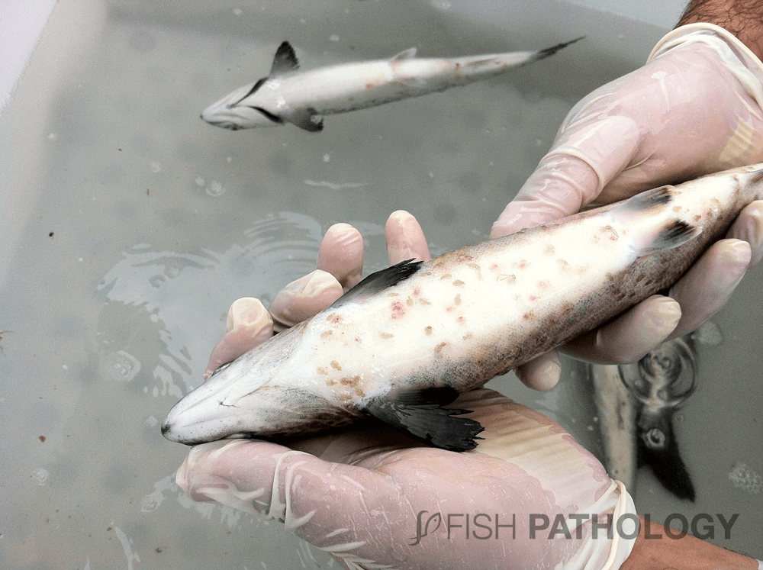
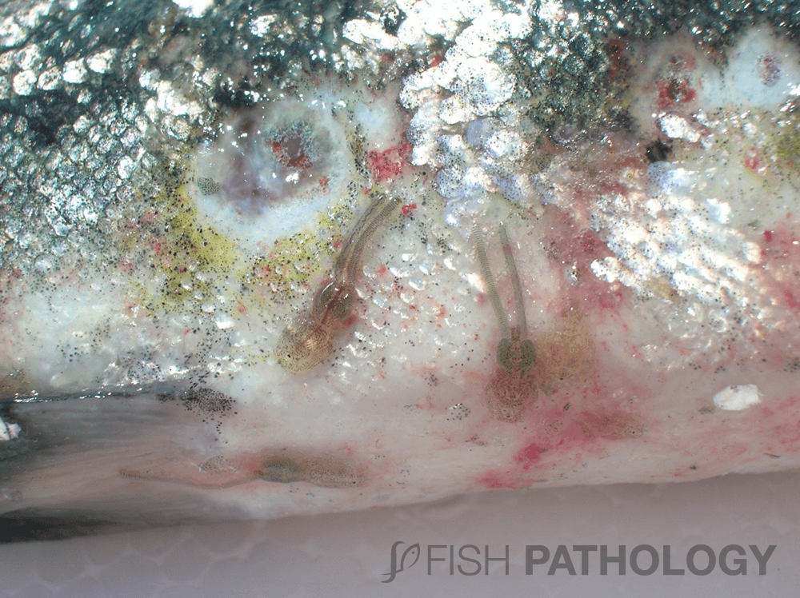
Atlantic Salmon and Sea lice in Chile
Chile accounts for about 30% of global farmed salmon production and 2nd largest producer in the world (about ¾ is Atlantic salmon (S.salar))
Sea lice species in Chile: Caligus rogercresseyi
Notes:
Sea have caused Upwards of $500M annual loss world wide

Slide 17
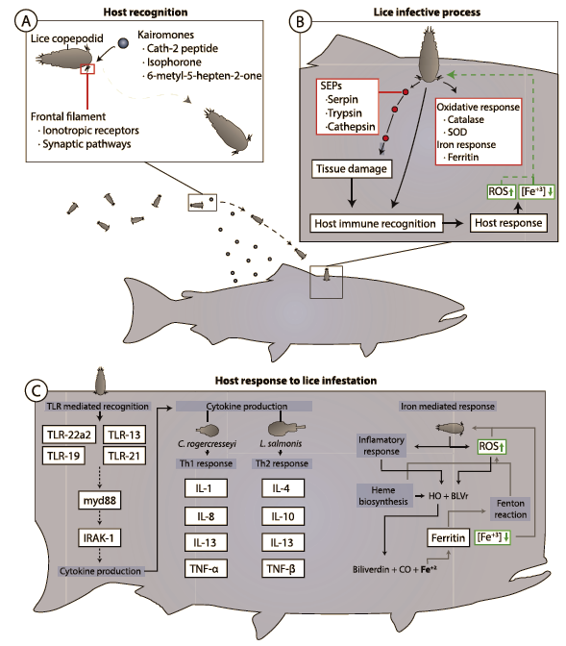
Sea lice – Salmon interaction

Slide 18
Sea lice – Salmon interaction
Generalized chronic stress response
Sea lice damage the attachment site (feed on skin, mucus, blood)
Secretes enzymes that degrade the mucus and help evade immune system
Changes in infested Salmon
Loss of epithelium
Bleeding
Increase in mucus secretion
Change in mucus composition
Tissue necrosis
Loss of skin as barrier
Increased expression of il10 and il4 (Th2 immune response) Valenzuela-Munoz et al 2016
Activation of the innate immune system (associated with tlr22a2 expression)
High expression of inflammatory and oxidative stress response genes (boltana, 2016)
Nutrition immune response
Reduce iron availability to the parasite (iron modulation and binding transcripts observed Valenzuela-munoz 2017)
438 lncRNAs modulated by C.rogercresseyi (Tarifeno-Saldivia 2017); 3678 lncRNAs modulated by C.rogercresseyi (Valenzuela=Munoz 2018)
Analysis of neighbor genes show lncRNAs may be involved in immune response in Atlantic salmon and in tissue repair in Coho

Slide 19
Environment influence on epigenome

Slide 20
Does the environment change the salmon response to sea lice?

Slide 21
Experimental set-up
8 fish/tank, 35 sea lice/fish, 4 tanks/treatment for 30 days
sea lice
no sea lice
Reduced-Representation
Bisulfite Sequencing
8°C
MspI +TaqαI digest
16°C
32 psu
26 psu
Notes:
add

Slide 22
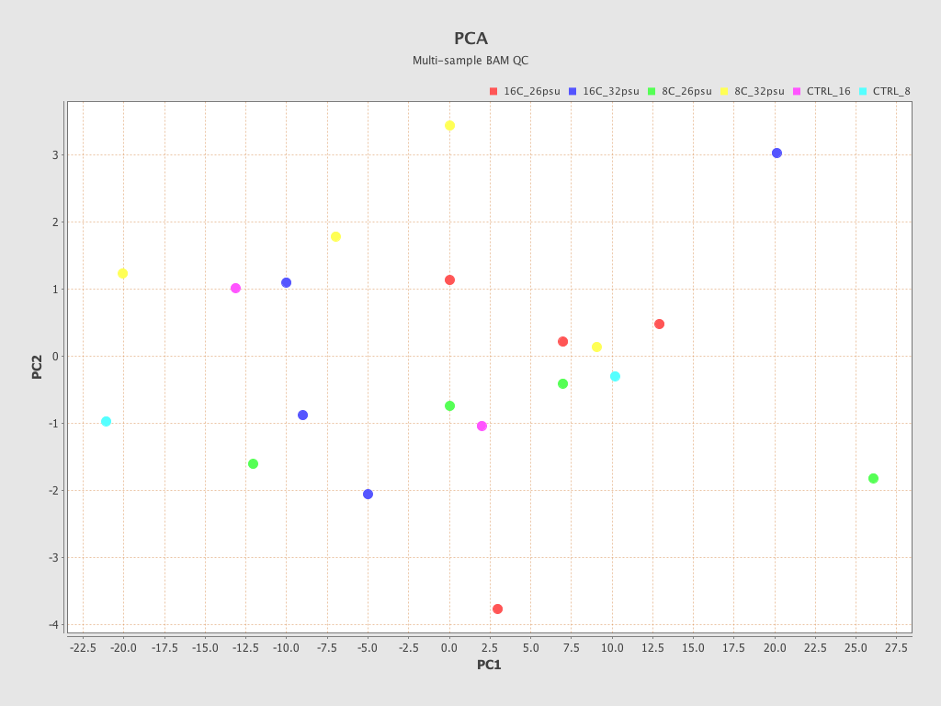
PCA of all RRBS data
Are these samples different?

Slide 23
DMR: Differentially methylated region
~250bp site
containing at least 3 CpGs that are significantly differentially methylated than expected from genetic origins of methylation variation
AND
with significantly different methylation across experimental groups (ANOVA)
Observed mCpG
Randomly shuffle data
Sample | # reads with mCpG | # reads with any CpG
16C_32psu_1 | 5 | 5
16C_32psu_2 | 12 | 100
16C_32psu_3 | 6 | 10
16C_32psu_4 | 30 | 50
8C_32psu_1 | 15 | 20
8C_26psu_3 | 11 | 15
CTRL_8C_26psu_1 | 0 | 21
CTRL_8C_26psu_2 | 5 | 60
CTRL_16C_26psu_1 | 0 | 0
Sample | # reads with mCpG | # reads with any CpG
16C_32psu_1
16C_32psu_2
16C_32psu_3
16C_32psu_4
8C_32psu_1
8C_26psu_3
CTRL_8C_26psu_1
CTRL_8C_26psu_2
CTRL_16C_26psu_1
Notes:
Filtered at 5x coverage within a sample and 3x coverage by individuals within a group

Slide 24
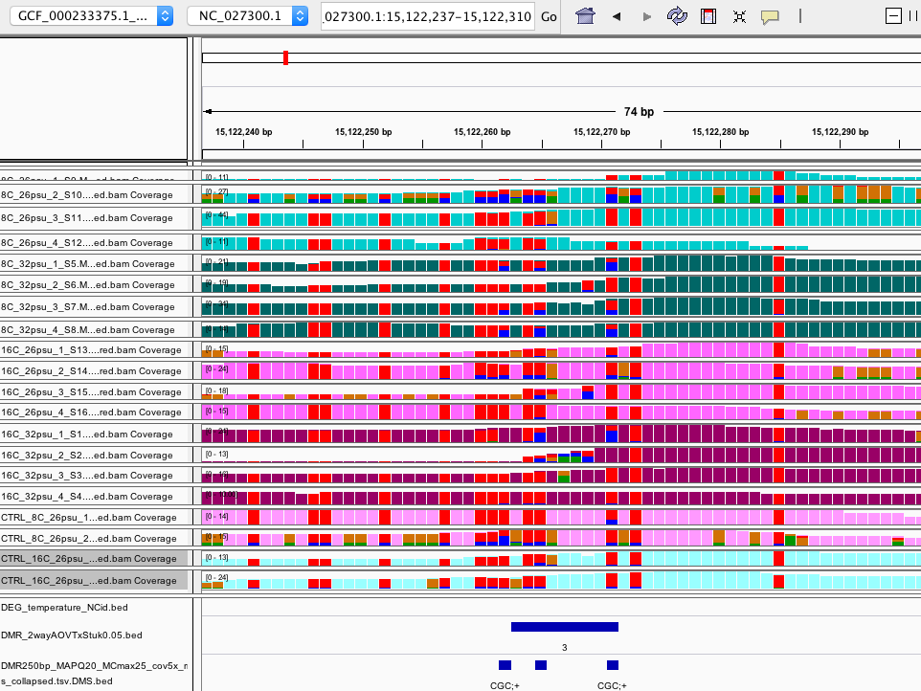
Example of DMR
Notes:
Don’t show unless bed graph. This is showing coverage/cpg (% methylation is the %blue or % orange)

Slide 25
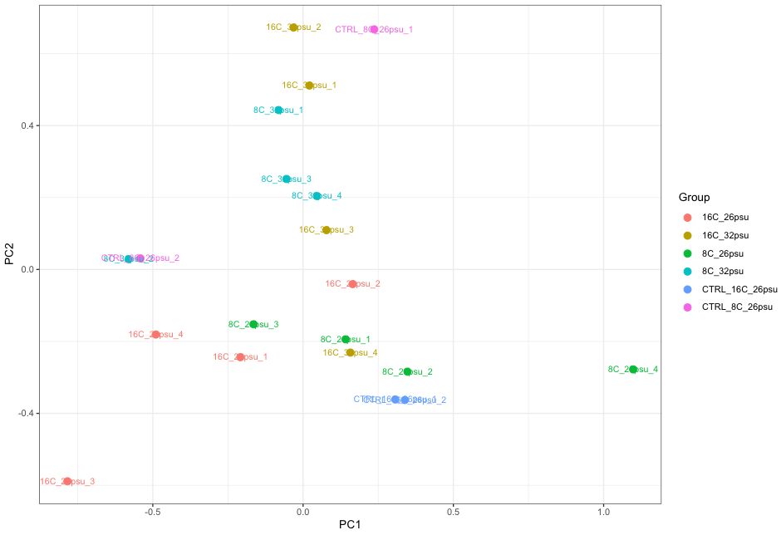
PCA of DMRs before group stats
In general salinity groups separate on PC2
Temperature groups separate on PC1 except
189 DMRs

Slide 26
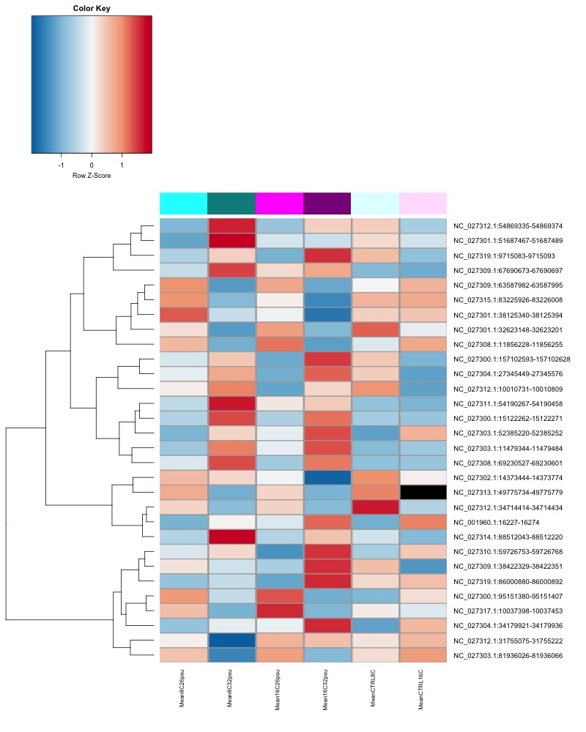
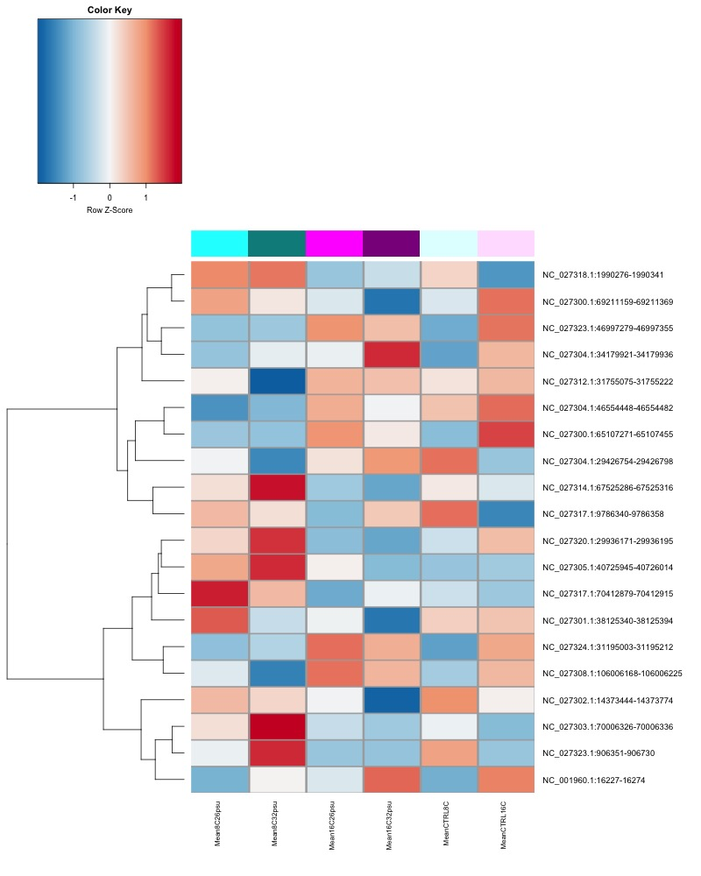
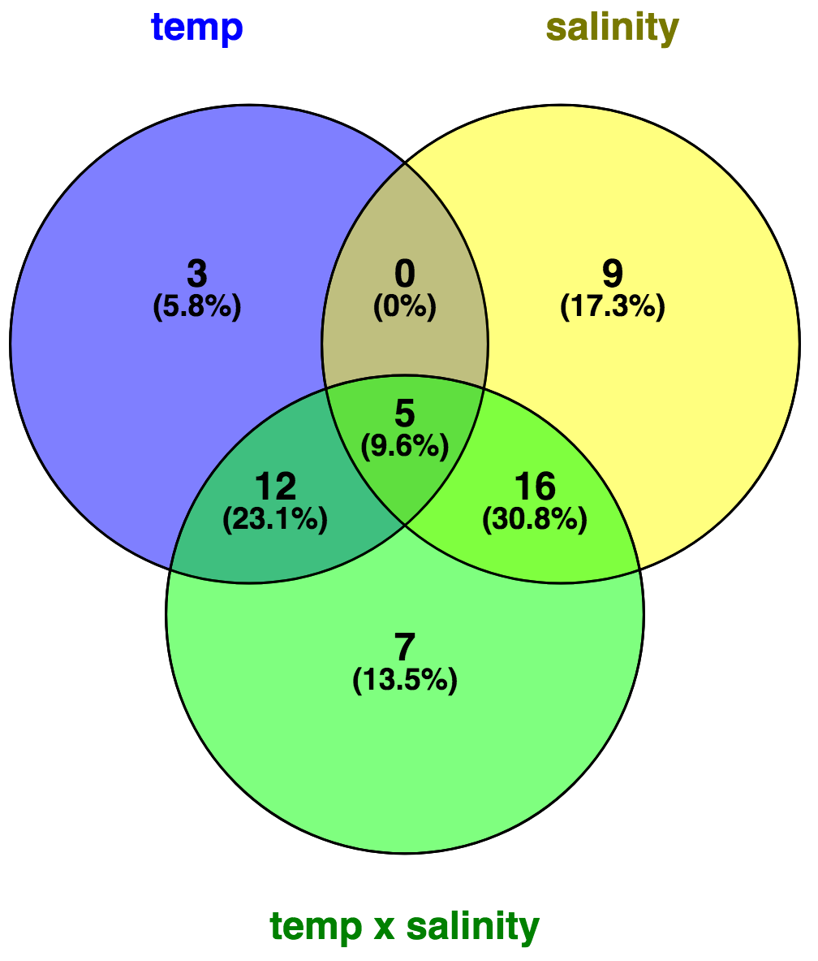
52 significant DMRs
30 DMRs with significant salinity effect
(2-way ANOVA p.adj < 0.05)
20 DMRs with significant temperature effect
(2-way ANOVA p.adj < 0.05)
Sea lice
No
sea lice
Sea lice
No
sea lice
Relative % methylation
Relative % methylation
8°C
26PSU
8°C
32PSU
16°C
26PSU
16°C
32PSU
8°C
26PSU
16°C
26PSU
8°C
26PSU
8°C
32PSU
16°C
26PSU
16°C
32PSU
8°C
26PSU
16°C
26PSU

Slide 28
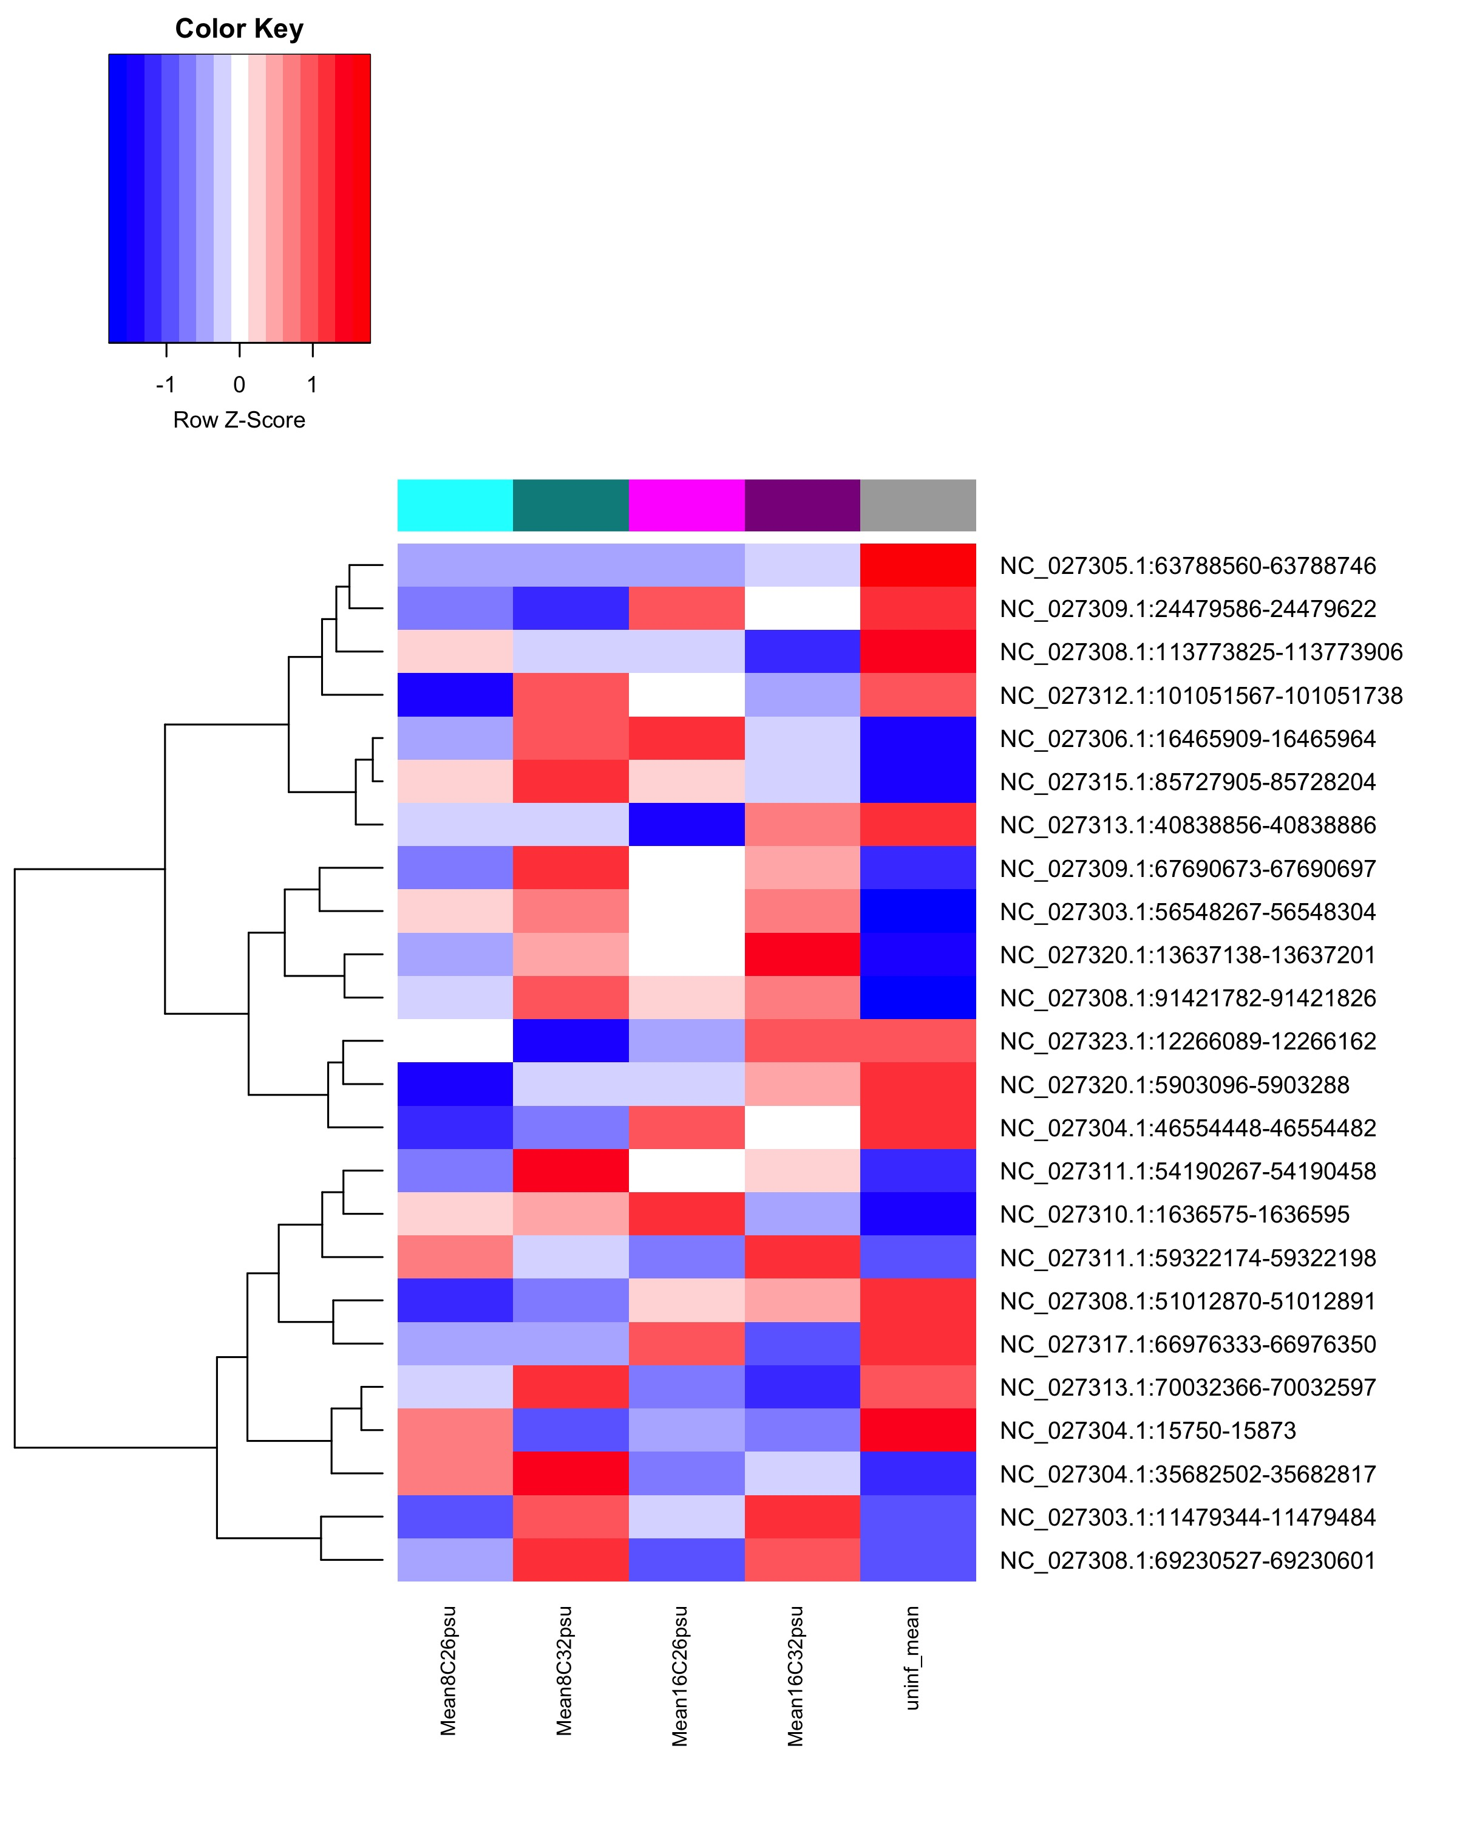
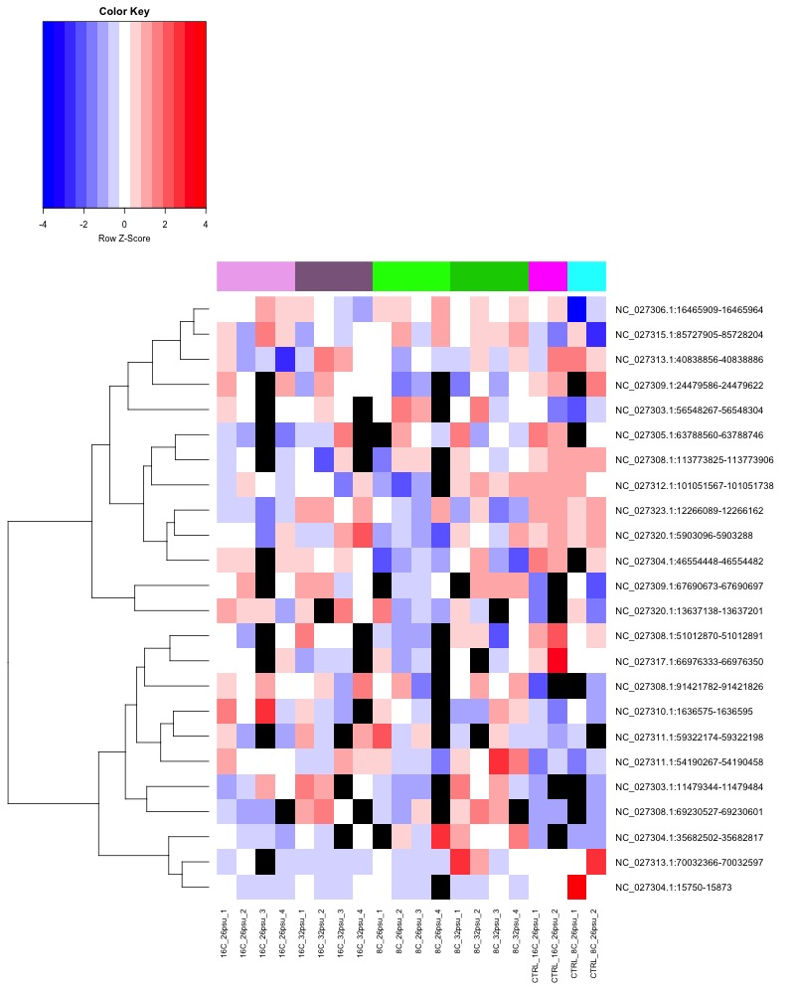
Heatmap of DMRs?
24 DMRs significant @ p < 0.1
1 way ANOVA, sea lice status
Sea lice
No
sea lice
Infested vs. not infested
8°C
26PSU
8°C
32PSU
16°C
26PSU
16°C
32PSU
Sea lice
No sea lice
8°C 26PSU
8°C 32PSU
16°C
26PSU
8°C
26PSU

Slide 29
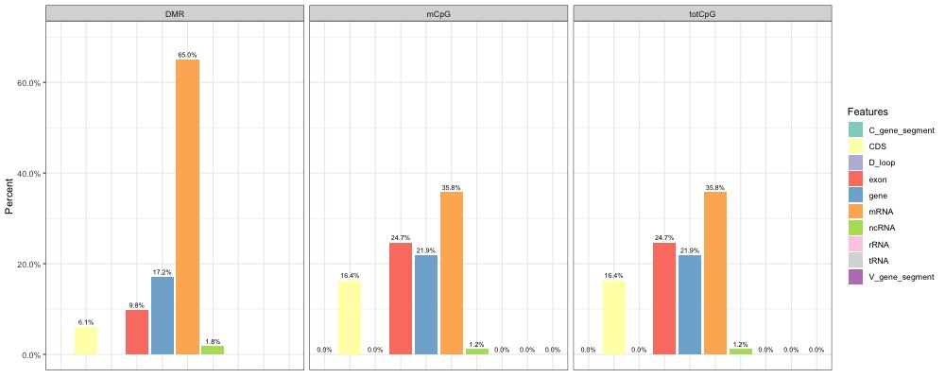
Where DMRs are
Overlap with genome features

Slide 30
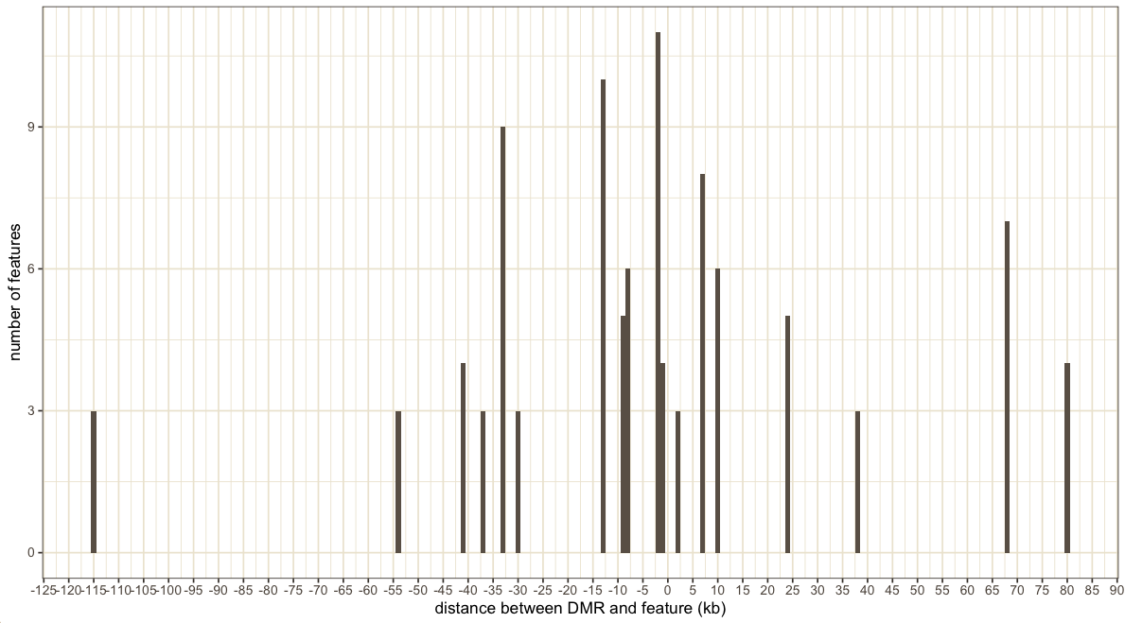
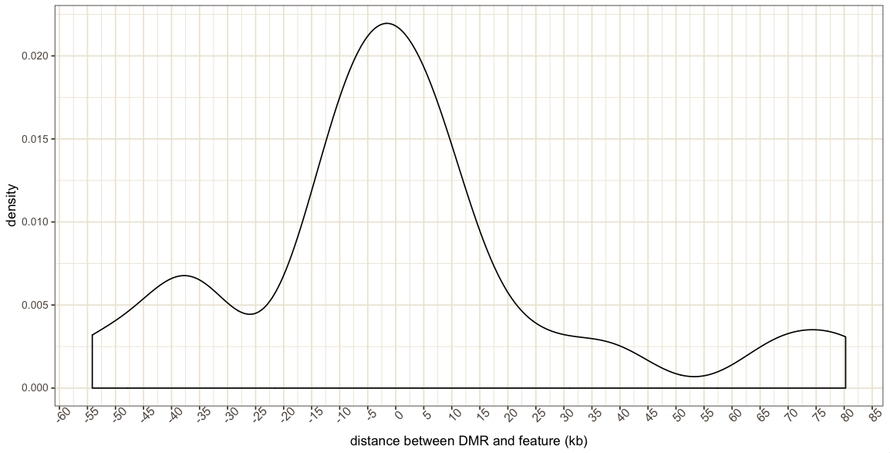
Where are DMRs that aren’t in features?
24/52 (46%) DMRs not overlapping with features
Closest features

Slide 31
Functions
Look at GO terms for +/- 2500bp closest features (including overlap)
temperature hypo
temperature hyper
Salinity hypo
Salinity hyper
Overlap with DEGs from Gustavo’s analysis

